Slide 1

Self-Balancing Unicycle
Client: Andy Chang (National Instruments)
Supervisor: Dr. Robert Throne
Leader: Kevin Collins
Members: Spencer Carver
Ander Solorzano
Ruffin White-Magner
Team
G
Notes:
Kevin

Slide 2
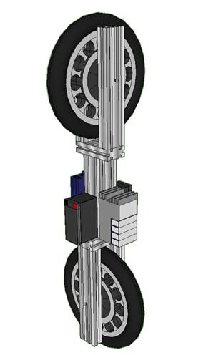
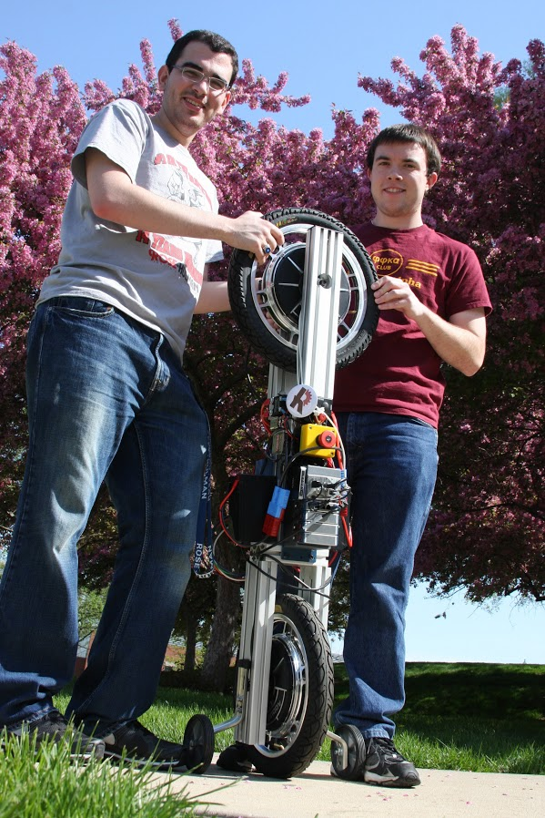
Project Overview
Project Plan
Status
Parts
Controls
Modeling
Conclusion
Build a self-balancing robotic unicycle for National Instruments (NI), using NI components where possible
Notes:
Kevin – 30 sec
We have been asked by national instruments to design and build a self balancing unicycle robot to showcase NI’s newest robotics toolkit.
National Instruments has developed a full solution to solving challenging controls problems with real time components, and this project is meant to show how a challenging controls problem can be solved using their components.
Our task is to develop a self balancing, autonomous unicycle style robot that can withstand disturbances such as light pushing. It does not have to navigate to a specific point or move at all, it only needs to balance independantly.

Slide 3
Overview
Status
Parts
Controls
Modeling
Conclusion
Project Plan - Overview
Several Aspects to the Project:
Robotics Environment Simulator
Physical Construction
Mathematical Modeling
Electrical Wiring
Controls
Notes:
Kevin – 30 sec

Slide 4
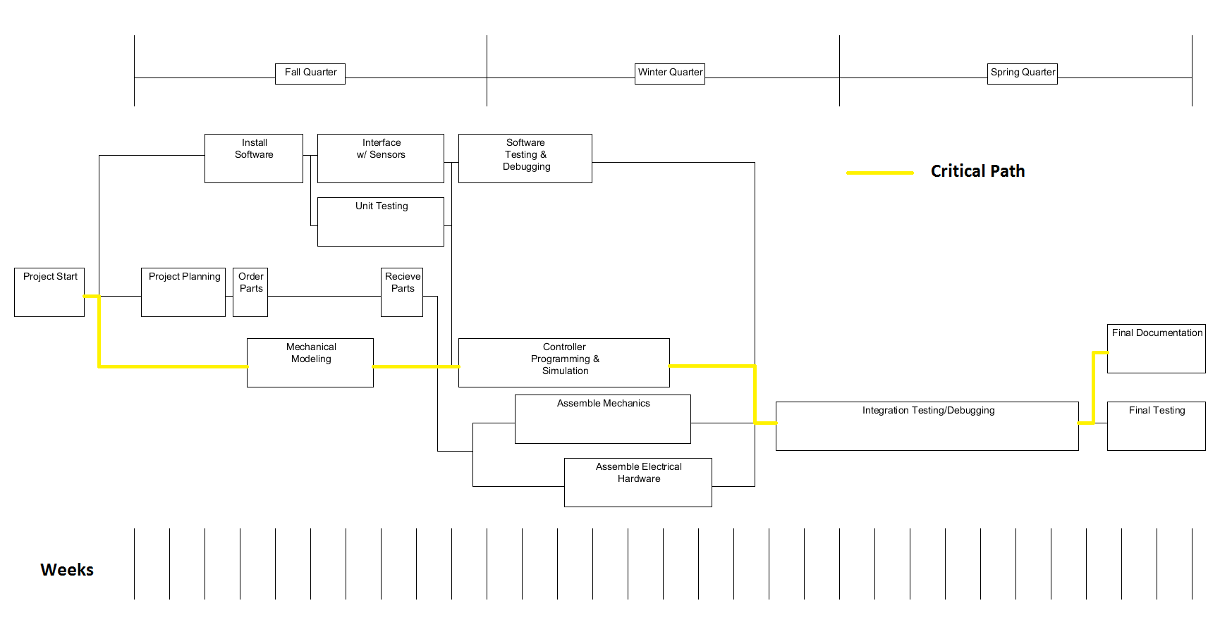
Overview
Status
Parts
Controls
Modeling
Conclusion
Project Plan – Planning Flow Chart
Notes:
Kevin – 30 seconds
Here you can see our project plan. The green line represents our current position in the plan, the checkboxes representing what has been accomplished. The fall has been and will continue to be primarily laying the groundwork for our project. We would like to have all of our components and make sure that we understand how they work and how to use them effectively. Then next quarter, we will be able to quickly and efficiently develop a control algorithm and build a physical model that will hopefully result in a working prototype by the end of the quarter. Then spring quarter is left entirely for debugging and final documentation.

Slide 5
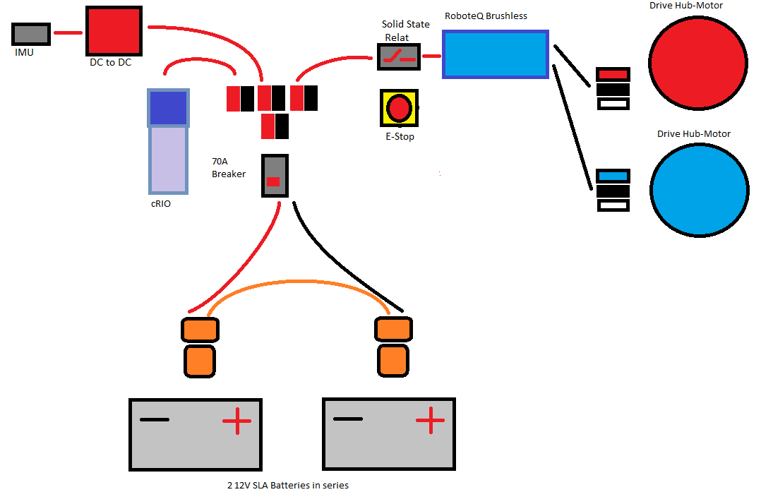
Project Construction - Electrical
Notes:
Ruffin – 30 sec
Labview Robotics Simulation Builder
With actuator and sensors
Build levels of complexity

Slide 6
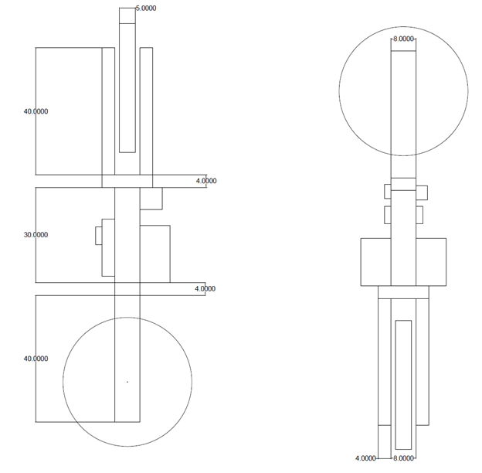
Project Construction - Mechanical
Notes:
Kevin – 30 seconds

Slide 7
Overview
Project Plan
Parts
Controls
Modeling
Conclusion
Project Software
Notes:
Kevin

Slide 8
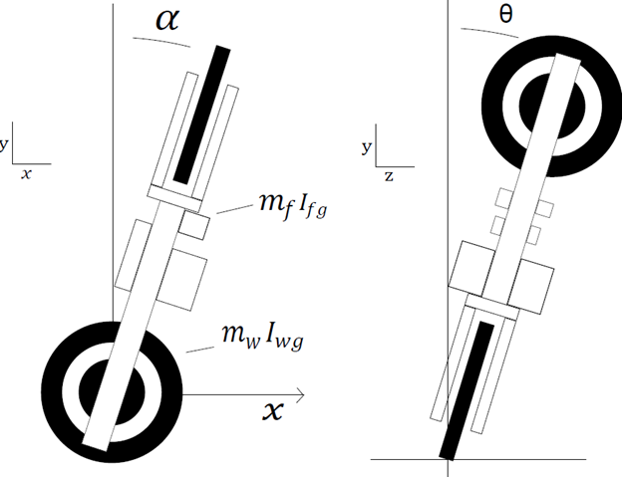
Overview
Project Plan
Status
Parts
Modeling
Conclusion
Mathematical Modeling
Notes:
Kevin – 30 seconds

Slide 9
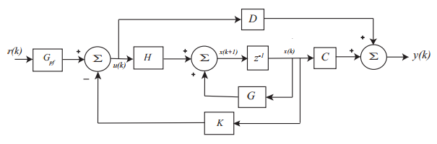


Overview
Project Plan
Status
Parts
Modeling
Conclusion
Control Strategies
Non-linear problem → Linearize → Use state variable description
Discrete time state variable feedback system
State Variable Equations
x(k) = state vector
u(k) = input vector to the plant
y(k) = output vector from the plant
G,H,C,D matrices are constant
K = feedback gain matrix
$$x\left(k+1\right)=G∗x\left(k\right)+H∗u\left(k\right)$$
$$y\left(k\right)=C∗x\left(k\right)+D∗u(k)$$
Notes:
Ander – 2 min

Slide 10
Overview
Project Plan
Parts
Controls
Modeling
Conclusion
Current Status
Goal | Percent Complete
Simulation in LabVIEW | 100%
Physical Prototype Constructed | 100%
Balances in One Dimension | 75%
Balances in Two Dimensions | 20%
Controller Designed | 100%
Mathematical Model Designed | 100%
Notes:
Kevin

Slide 11
Overview
Project Plan
Parts
Controls
Modeling
Conclusion
Current Status – Progress
Demo
Notes:
Kevin

Slide 12
Overview
Project Plan
Parts
Controls
Modeling
Conclusion
Recommendations
Moment of Inertia Calculations
Improved Safety Rig
Notes:
Kevin

Slide 13
Overview
Project Plan
Status
Parts
Controls
Modeling
Conclusion - Questions
Budget
Simulator
Wiring Diagram
System Modeling
Controls
Hours
Notes:
Kevin

Slide 14
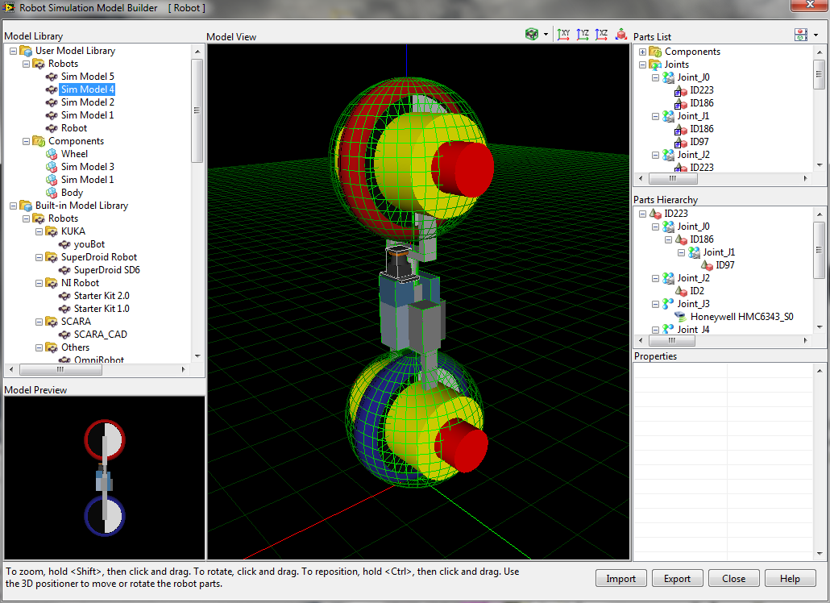
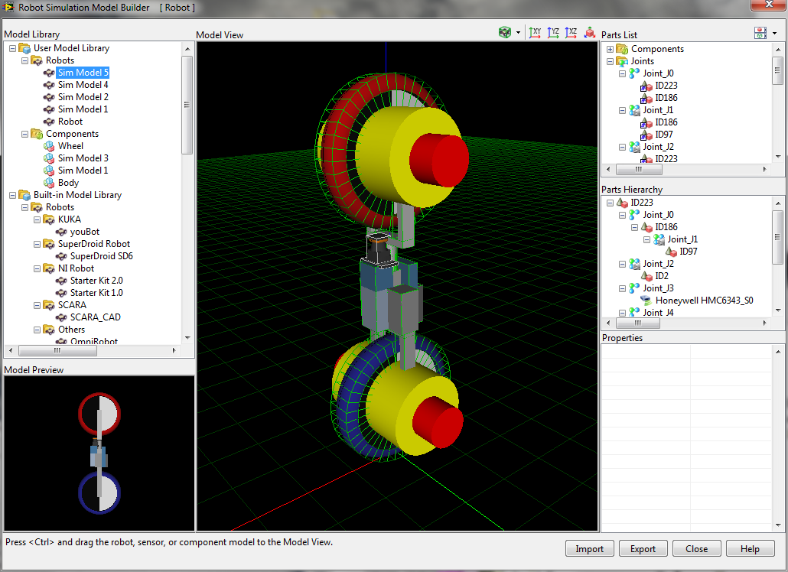
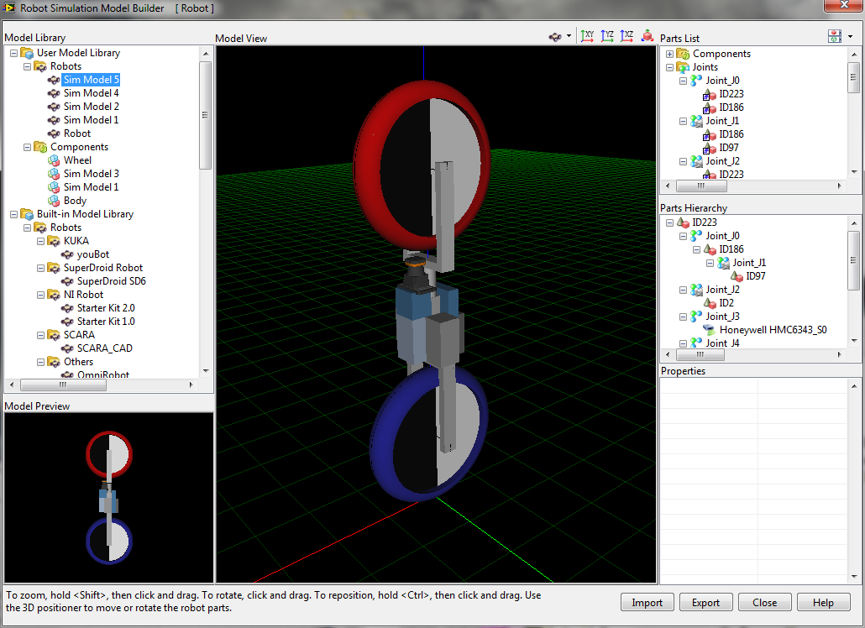
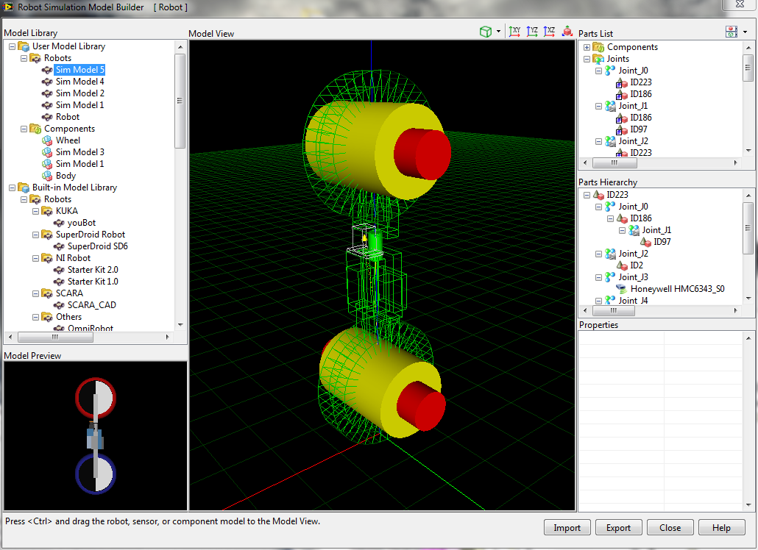
Simulation
Notes:
Ruffin
Labview Robotics Simulation Builder
With actuator and sensors
Build levels of complexity

Slide 15
Determining Parts – Budget
Total Cost: $27,740
Notes:
Spencer

Slide 16
Determining Parts – Budget
Total Cost: $4,740
Notes:
Spencer

Slide 17
Overview
Project Plan
Parts
Controls
Modeling
Conclusion
Current Status – Team Progress
Hours spent on project as of 10/15/2012: 165
Spencer Carver: 34
Kevin Collins: 40
Ander Solorzano: 37.5
Ruffin White-Magner: 53.5
Tasks Recently Completed:
Mechanical Model – Kevin Collins & Ruffin White-Magner
Receive Parts– Ander Solorzano
Tasks Currently In Progress:
Simulation – Kevin Collins & Ruffin White-Magner
Interface w/ Sensors – Spencer Carver, Ander Solorzano, & Ruffin White-Magner
Research Real-Time VIs – Spencer Carver & Ander Solorzano
Notes:
Kevin

Slide 18
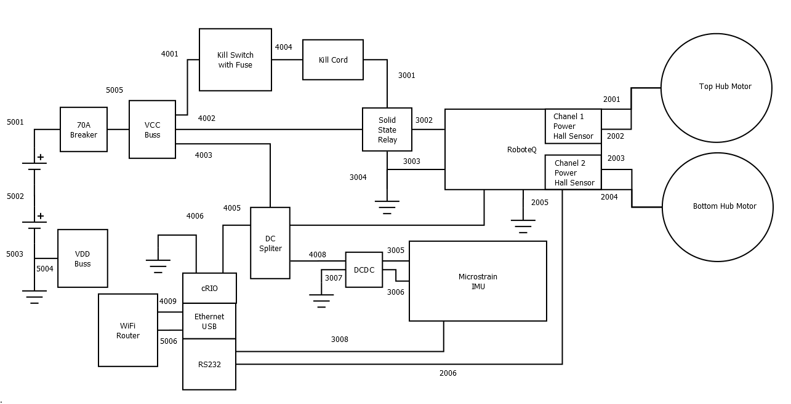
Wiring Diagram
Notes:
Kevin

Slide 19
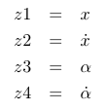
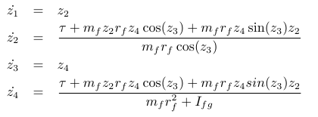
Mathematical Modeling
State Variables
State Equations
Notes:
Kevin

Slide 20
Mathematical Modeling
State Variables
State Equations
Notes:
Kevin

Slide 21
Hours
Total Team Hours - 784
Notes:
Kevin

